Slide 1
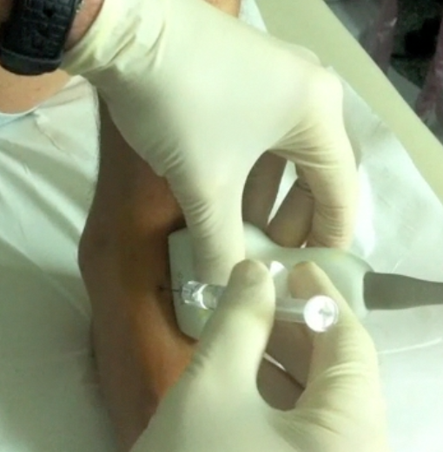
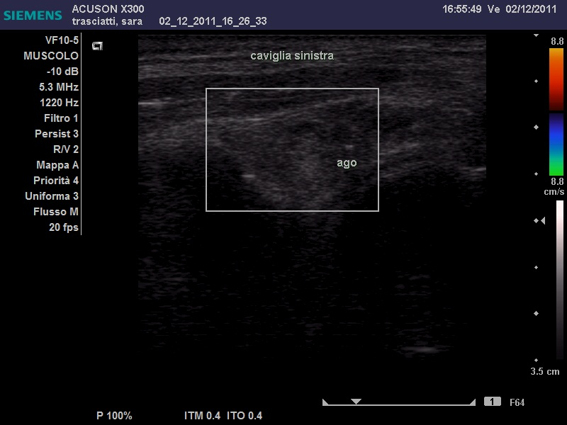
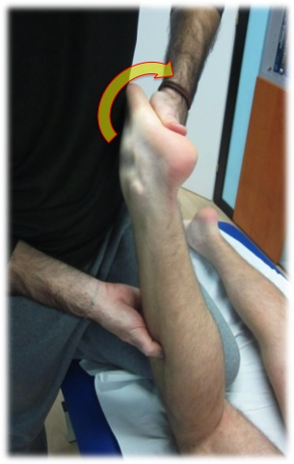
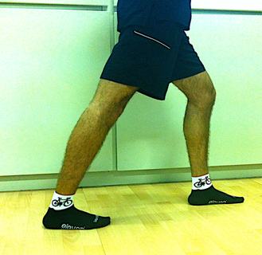
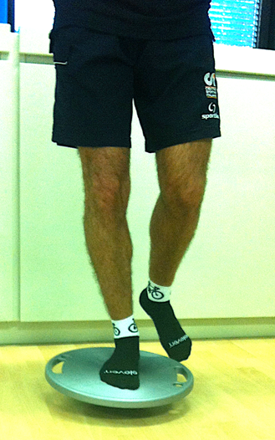
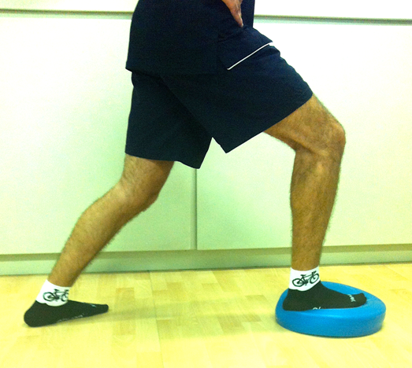
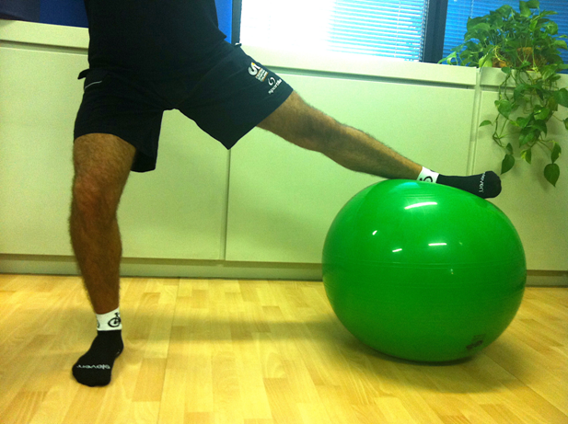
INTRA-ARTICULAR ULTRASOUND-GUIDED INJECTIONS IN AGONISTIC AND NON-AGONISTIC ATHLETES AFFECTED BY ANKLE OSTEOARTHRITIS
Boni G¹, Spaccapanico Proietti S¹, Ferri AC¹, Bizzi E², Migliore A²
1. CR Umbria - FMSI - Surgery of Sport Medicine – Foligno (Italy)
2.); Italy S. Pietro FBF Hospital, Rome; Italy
AIM:
To investigate the eventual efficacy and safety profiles of intra-articular ultrasound-guided hyaluronic acid (HA) injections associated with rehabilitation in athletes affected by ankle osteoarthritis.
Methods:
In the years from 2008 to 2011 over 220 athletes received an intra-articular ultrasound-guided HA injection for a condition of osteoarthritis; 16 athletes were affected by ankle osteoarthritis, mean age 34.68, min. 14 and maximum 61. Two boys aged 14, male, and 15, female, had cartilage lesion shown on MRI after ankle sprain. Medium-weight hyaluronans were used. All patients were evaluated by means of pain VAS and FADI sport (foot and ankle disability sport index) antero-posterior standing range of motion by the use of a goniometer at baseline and after 6 months. All injections were ultrasound-guided. All patients also underwent a variable number of rehabilitation sessions. All adverse events were recorded.
Access to the joint is between the tendon of the extensor hallucis longus and the tendon of the extensor digitorum longus (Fig.1). A total of 48 injections was administered (three injections for each patient every two weeks). The potential for treating osteoarthritis of the ankle joint by viscosupplementation has been suggested in literature, however, no dosing studies have been published to date, and dosing in the ankle joint remains an area for discussion. We used 2 ml of medium weight Ha for each infiltration, well tolerated by the patients. Just before the infiltration, the therapist prepared the joint to receive HA releasing the soft tissues.
The rehabilitation protocol consisted in a programme of manual therapy lasting 6 to 8 weeks, preceded by clinical examination to assess active and passive movements of the ankle. We tried to reproduce the same pain that patients report during their daily activities: jumping with one leg, stepping up, the rotation of the talus, running, standing for a long period, going up and down the stairs, are some activities which we have reproduced in the clinic.
We have developed the programme of rehabilitation of the ankle carefully observing the presence of provoked pain during movements in different spatial planes.
Treatment in Manual Therapy consisted of a specific set of mobilization techniques to counter the restrictions of the movements themselves.
We also used the positions of static stretching to increase the range of motion and improve the elasticity of the soft tissues.
Each patient was subjected to a specific programme of active training involving a series of exercises to improve the strength and control joints.
For this purpose we used elastic resistance exercises, functional movements and training pitch and balance. (Fig.2)
Fig.1 HA Injection
Fig.2 Examples of Rehabilitation Interventions
Results:
12 agonistic athletes from different disciplines and 4 non agonistic athletes made up the group of patients affected by ankle osteoarthritis which underwent intra-articular injections of hyaluronic acid. All patients correctly performed rehabilitation sessions. Range of motion improved by 37% in agonistic athletes and by 29% in non agonistic athletes. Pain VAS decreased by 76,4% in agonistic athletes and by 80% in non agonistic athletes and FADI sport decreased by 60% in agonistic and 65% in non agonistic athletes. All athletes recovered complete sport activity. No systemic or local adverse events were reported.
Discussion:
The use of intra-articular hyaluronic acid injections by ultrasound-guidance seems to be in our experience a valid tool for athletes suffering from ankle osteoarthritis, with good efficacy and safety profiles. Further studies are needed to confirm such data.
References:
de Souza MV, Venturini C, Teixeira LM, Chagas MH, de Resende MA.Force-displacement relationship during anteroposterior mobilization of the ankle joint. J Manipulative Physiol Ther. 2008 May;31(4):285-92
Vaillant J, Rouland A, Martigné P, Braujou R, Nissen MJ, Caillat-Miousse JL, Vuillerme N, Nougier V, Juvin R. Massage and mobilization of the feet and ankles in elderly adults: effect on clinical balance performance. Man Ther. 2009 Dec;14(6):661-4
Fujii M, Suzuki D, Uchiyama E, Muraki T, Teramoto A, Aoki M, Miyamoto S.Does distal tibiofibular joint mobilization decrease limitation of ankle dorsiflexion? Man Ther. 2010 Feb;15(1):117-21.
Epub 2011 Feb 1.
Yeo HK, Wright A.Hypoalgesic effect of a passive accessory mobilisation technique in patients with lateral ankle pain. Man Ther. 2011 Aug;16(4):373-7.
Migliore A, Giovannangeli F, Bizzi E, Massafra U, Alimonti A, Laganà B, Diamanti Picchianti A, Germano V, Granata M, Piscitelli P.Viscosupplementation in the management of ankle osteoarthritis: a review. Arch Orthop Trauma Surg. 2011 Jan;131(1):139-47. Epub 2010 Aug 10.
.

